Slide 1
An Analysis of Film Industry Performance
Nicholas De Santos
DSC 530

Slide 2
Introduction and Motivation
The main purpose of this project is to do an analysis of what kind of factors and characteristics (if any) of different movies can help us determine how successful a movie will be. Specifically, two measures of success that we might be looking at during this analysis is first and foremost the amount of gross revenue the movie brought in as well as how popular the movie was with audiences. For the latter we will consider an IMDb rating as our variable to help measure this.

Slide 3
Background: The Data
The dataset that we are working with is a movie dataset containing information about 6820 different movie titles. The data was scraped from IMDb databases. There are movies from different years between 1986 and 2016. There are 220 movies per year and each movie has the following information included in the dataset:
Name: name of the movie
Rating: what was the movie rated (PG, PG-13, R etc)
Genre: what genre does the movie belong to
Year: year the movie was released
Released: release date
Score: IMDb score
Votes: count of IMDb votes
Director: who directed the movie
Writer: who wrote the movie
Star: major stars in the movie
Country: what country was the movie made
Budget: budget used to make movie
Gross: how much did the movie make
Company: what production company
Runtime: how long was the movie

Slide 4
Variable Selection
I selected "score" and "gross" as variables because there are the variables I am planning to use as a measure of success in this analysis of the film industry. Similarly, votes could also be used as a measure of success but the amount of votes can also be an indicator on how much revenue a movie will make. Other variables that I chose to include in this analysis are the budget of the movie and the runtime for each movie. The movie genre is the only variable that is a categorical one, hence it is the only one in which we cannot create a histogram for.

Slide 5
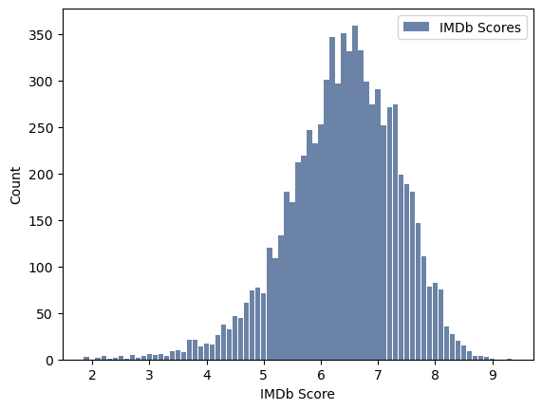
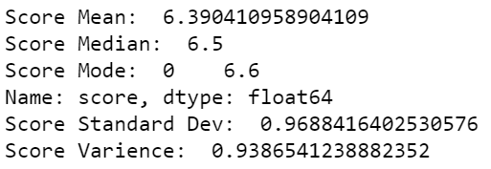
Histogram: “Score” Variable Analysis
Outliers: There doesn’t seem to be any extreme outliers in the distribution. Possibly on the left side.
Spread: There seems to be a slight skew to the left.
Behavior: Distribution appears to be more or less symmetrical. Majority of observations between 5 and 8.

Slide 6
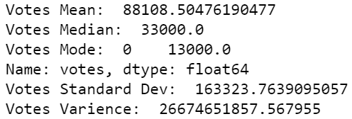
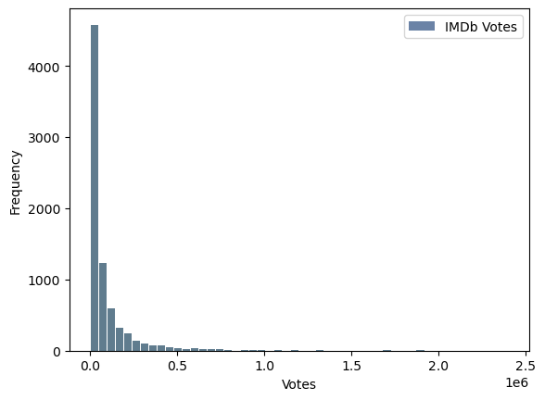
Histogram: “Votes” Variable Analysis
Outliers: There are definitely outliers on the right side of this distribution but it’s likely some movies are just more popular so there isn’t a reason to get rid of any outliers since the observations are possible.
Spread: Significant skew to the right
Behavior: Largest density on left side of distribution

Slide 7
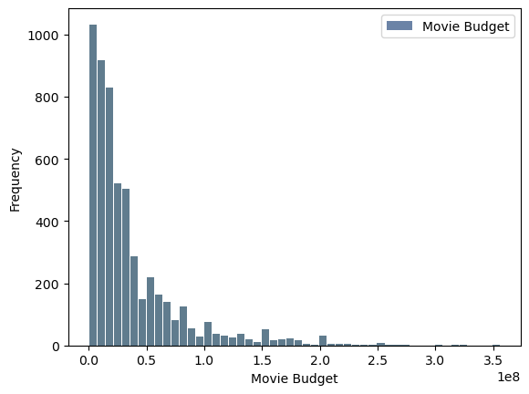
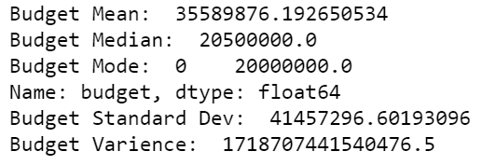
Histogram: “Budget” Variable Analysis
Outliers: Possible outliers on the right of the distribution but it’s possible movies could’ve had a large budget so no outliers will be removed.
Spread: Significant skew to the right
Behavior: Largest density at the left side of the distribution.

Slide 8
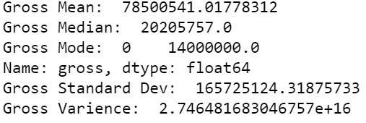
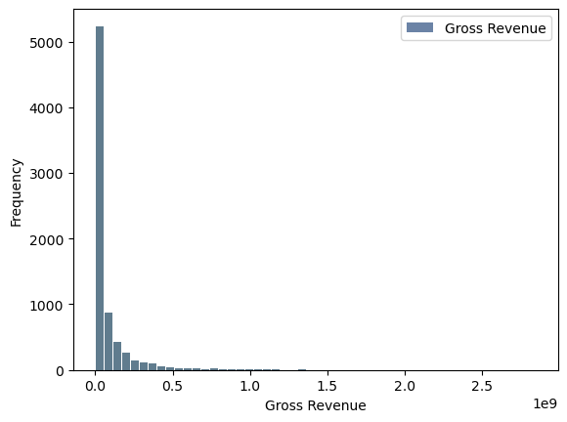
Histogram: “Gross” Variable Analysis
Outliers:Possible outliers to the right. Won’t be removed since it is not unlikely for some movies to make significantly more gross revenue than other movies.
Spread: Significant skew to the right
Behavior: Largest density to the left of the distribution.

Slide 9
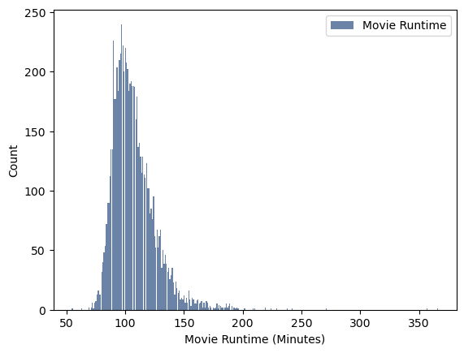
Histogram: “Runtime” Variable Analysis
Outliers: It looks like there are some possible outliers but they won’t be removed as they are real movies. Ex: There is a movie that is actually 6 hours long (The Best of Youth).
Spread: Slightly skewed to the right
Behavior: Biggest density around 75 to 125 minutes.

Slide 10
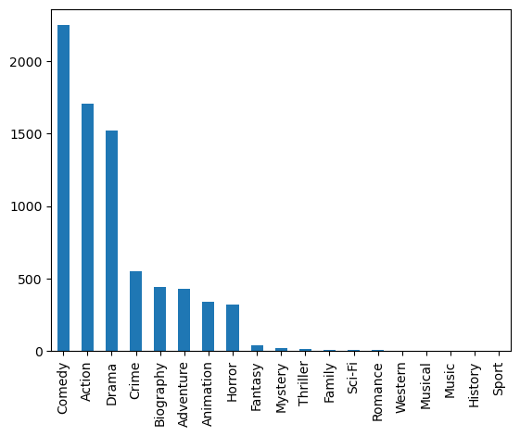
Bar Plot: “Genre” Variable Analysis
Because this is a categorical variable, there is no way to find a traditional average. We can only analyze the frequency of which each type of observation is observed. Based on the data, we see that there are more Comedy movies than any other genre. The least popular movie genre is “Sport”. In order, the top movie genres here are Comedy, Action, Drama, Crime, Biography, Adventure, Animation and Horror.

Slide 11
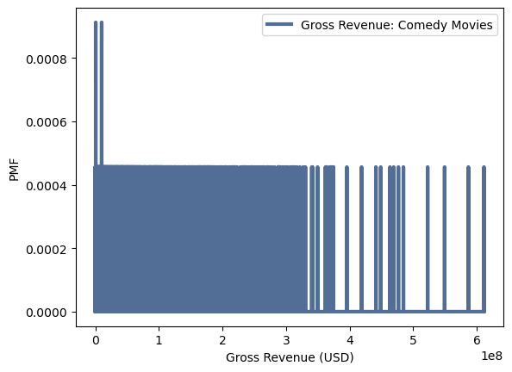
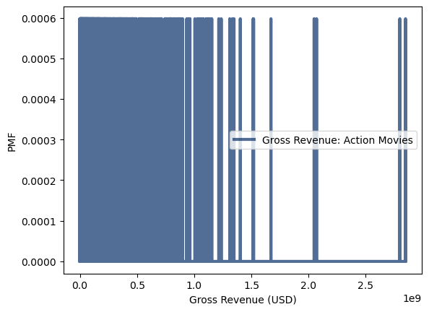
Analysis of Gross Revenue of Different Movie Genres (PMFs)

Slide 12
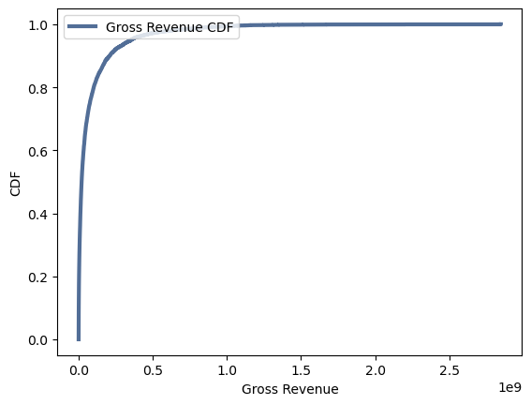
CDF of Gross Revenue
What does this tell us?
As you can see above, the CDF of the gross revenue for our data appears to follow a logarithmic path as it progresses. It's highly possible that the distribution for this variable is a lognormal distribution. If we look back to the histogram of this variable, it does appear to support this claim.

Slide 13
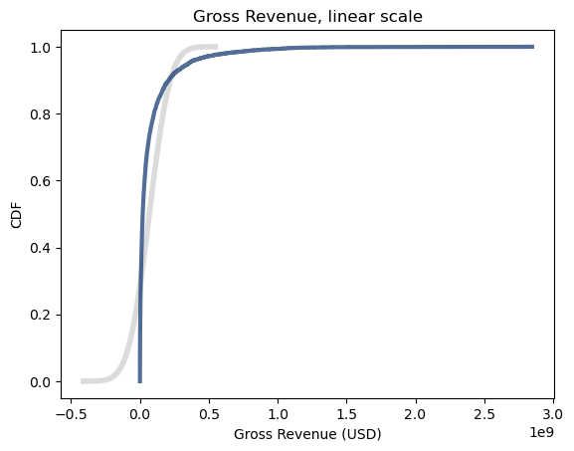
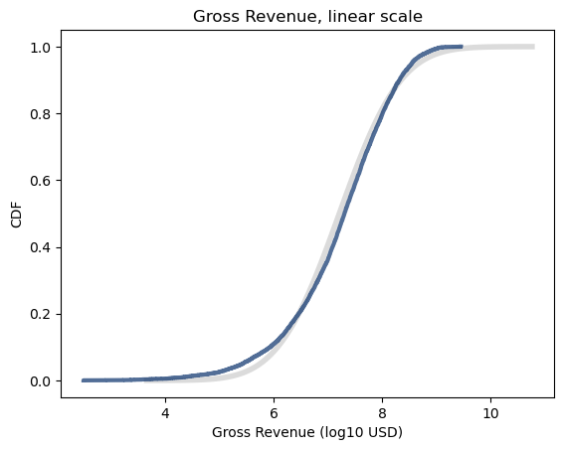
Analytical Distribution Plot

Slide 14
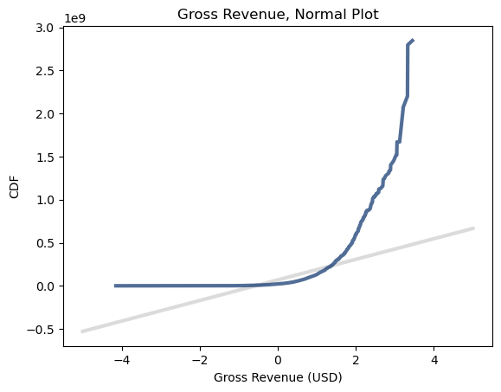
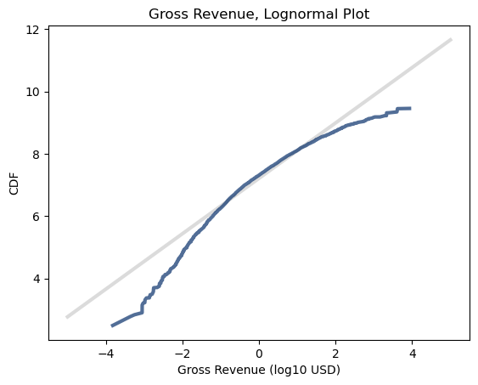
Analytical Distribution Plot

Slide 15
Analytical Distribution Plot
Previously I mentioned that the distribution of the Gross Revenue for the Movie Industry data set could possibly follow a log-normal distribution. Considering the figures above, it's clear to see that a log-normal distribution fits the data better than just a normal distribution. Through the graphs we see an improvement when we apply a logarithmic transformation to our data.

Slide 16
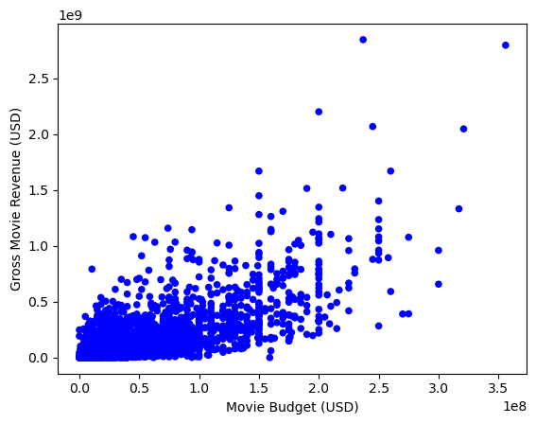

Variable Relationships: Scatter Plot of Budget and Gross Revenue

Slide 17
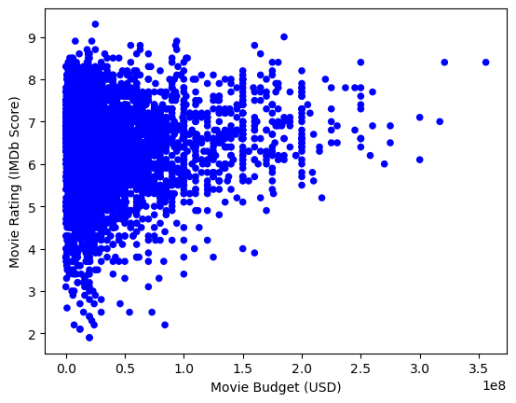

Variable Relationships: Scatter Plot of Budget and Movie Rating

Slide 18
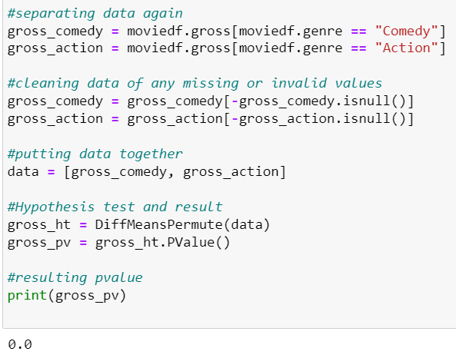
Hypothesis Testing
As you can see we got a resulting p-value of 0.0. This is of course not possible for an observed p-value but this could be a minor error due to the fact that there could have been some rounding off in some of our calculations. Because of this, if we resulting in a relatively small p-value, the computer system could have rounded the small value to zero. As we recall from previous lessons, when the p-value of a hypothesis test is extremely small, it's safe to say that we can reject the null hypothesis that the means of the two samples are the same and accept the alternative hypothesis that there is a difference between the gross revenue of Comedy movies and the gross revenue of Action movies.

Slide 19

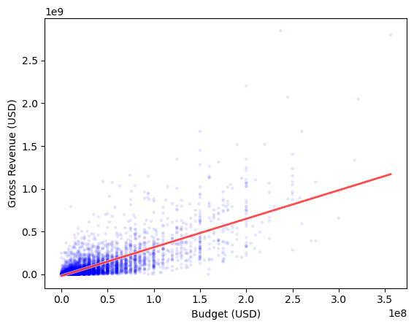
Regression Analysis
Our model for our Gross income is a linear model in the form of (approximately) f(x) = 3.3342x - 16825009.9530. Here f(x) represents the gross revenue generated as a function of x where x is the budget the movie had. In the end, these two variables had a correlation of 0.74 which makes this a decent model.

